Slide 1
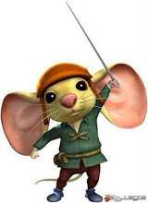
Fourth Grade ELA
Week Eight, Day Three
Novel Unit: The Tale of Despereaux
This session will be recorded for learning purposes. Learning purposes include: a lesson review for students who are absent, students who want to review for a test, etc. and will be distributed for learning purposes.

Slide 2
Daily Review RL 4.3 Describe in depth a character, setting, or event
Mig’s Life So Far…
First:
Next:
Then:
Notes:
Place students in breakout rooms with a buddy to complete. It can be short phrases (i.e. stole by her dad, lived with her uncle, servant in the castle)

Slide 3
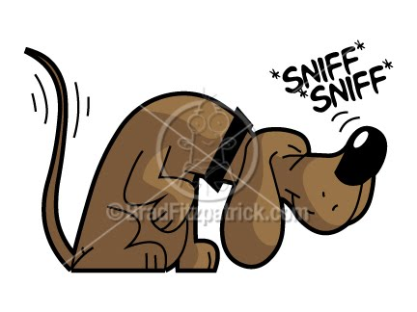
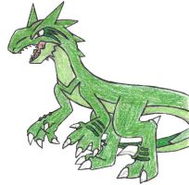
Vocabulary
olfactory = having to do with the nose or sense of smell
ominous = threatening, fearsome, scary
ferocious = savagely cruel or violent
tragic = characterized by extreme distress or sorrow
aspirations = a hope or ambition of achieving something.
Notes:
Ask students to read definitions on mic and discuss meanings WG

Slide 4
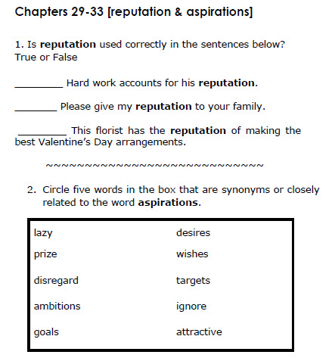
Vocabulary
Notes:
Place students in BO rooms to complete with a buddy

Slide 5
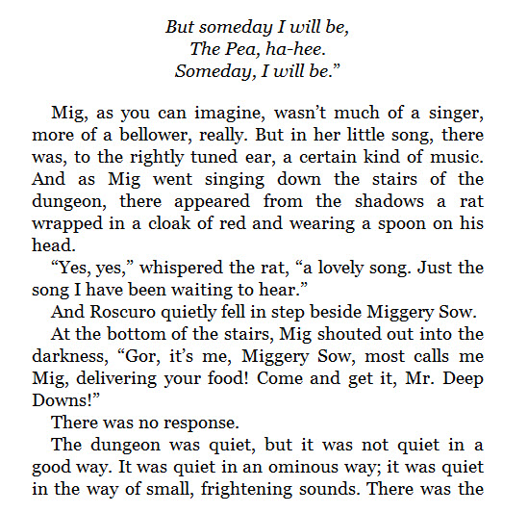
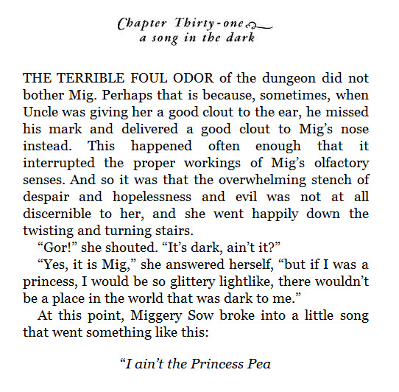
Teacher Read Aloud
Notes:
Ask for student responses in chat and on microphone

Slide 6
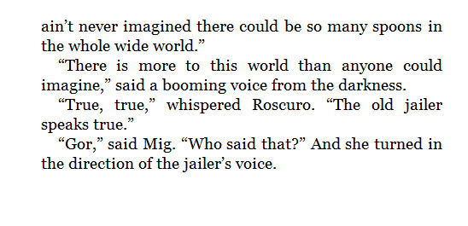
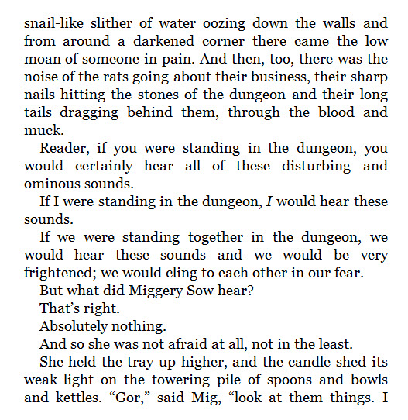
Teacher Read Aloud
How would you feel if you were in the dungeon? Why do think Mig does not feel afraid (RL 4.1)
Notes:
Ask for student responses in chat and on microphone

Slide 7
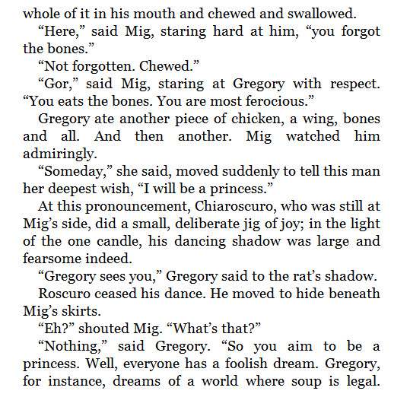
Teacher Read Aloud
Notes:
Ask for student responses in chat and on microphone

Slide 8
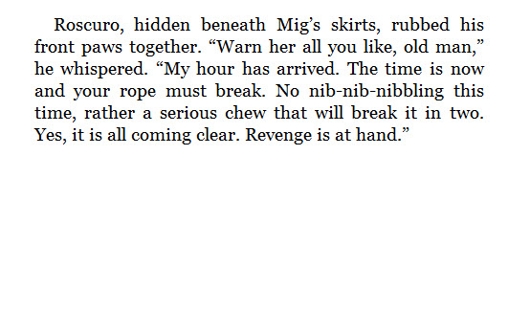
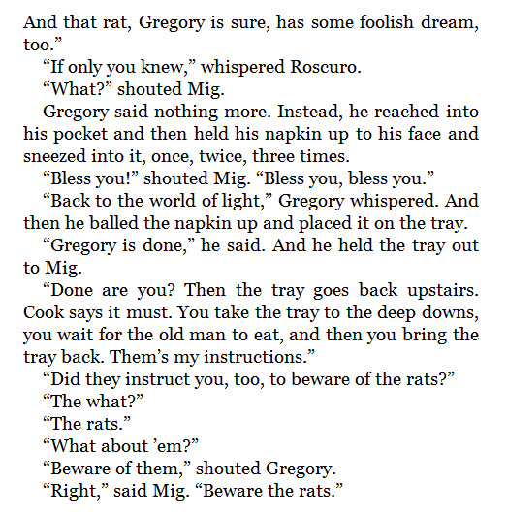
Teacher Read Aloud
Whom do you think Roscuro wants to seek revenge? What do you think he will do?
(RL 4.1)
Notes:
Ask for student responses in chat and on microphone

Slide 9
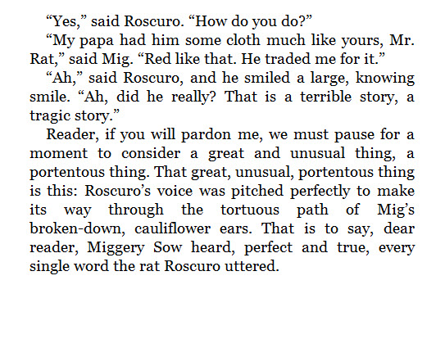
Teacher Read Aloud
Buddy Read
Who is Mig’s father?
(RL 4.1)
Notes:
Place students into BO rooms and ask students to read text and discuss questions

Slide 10
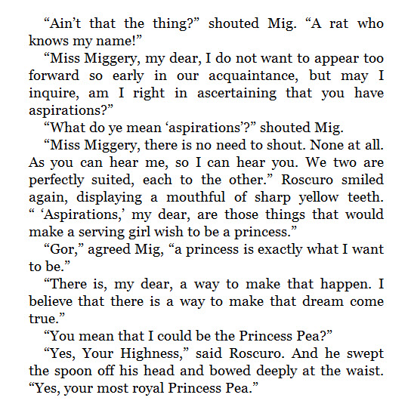
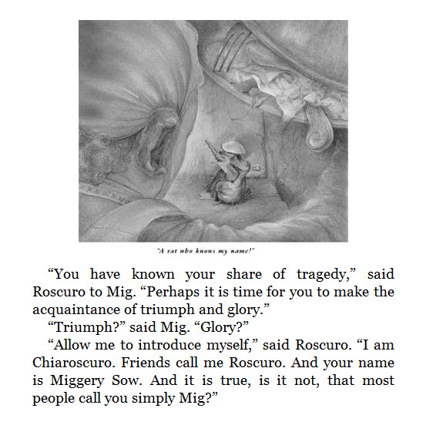
Teacher Read Aloud
Buddy Read
Do you think Roscuro really wants to help Mig become a princess ? Why or why not?
(RL 4.3)
Notes:
Place students into BO rooms and ask students to read text and discuss questions

Slide 11
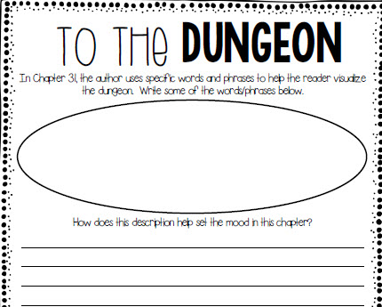
Teacher Read Aloud
Buddy Read
Notes:
Place students into BO rooms and ask students to read text and discuss questions

Slide 12
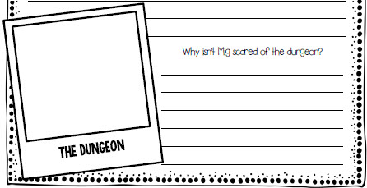
Teacher Read Aloud
Buddy Read

Slide 13
Closure
What do you think will happen in Book the Fourth? How will this story end?
Notes:
Review with students

Slide 14
Homework
Notes:
Discussion board?

